Slide 1
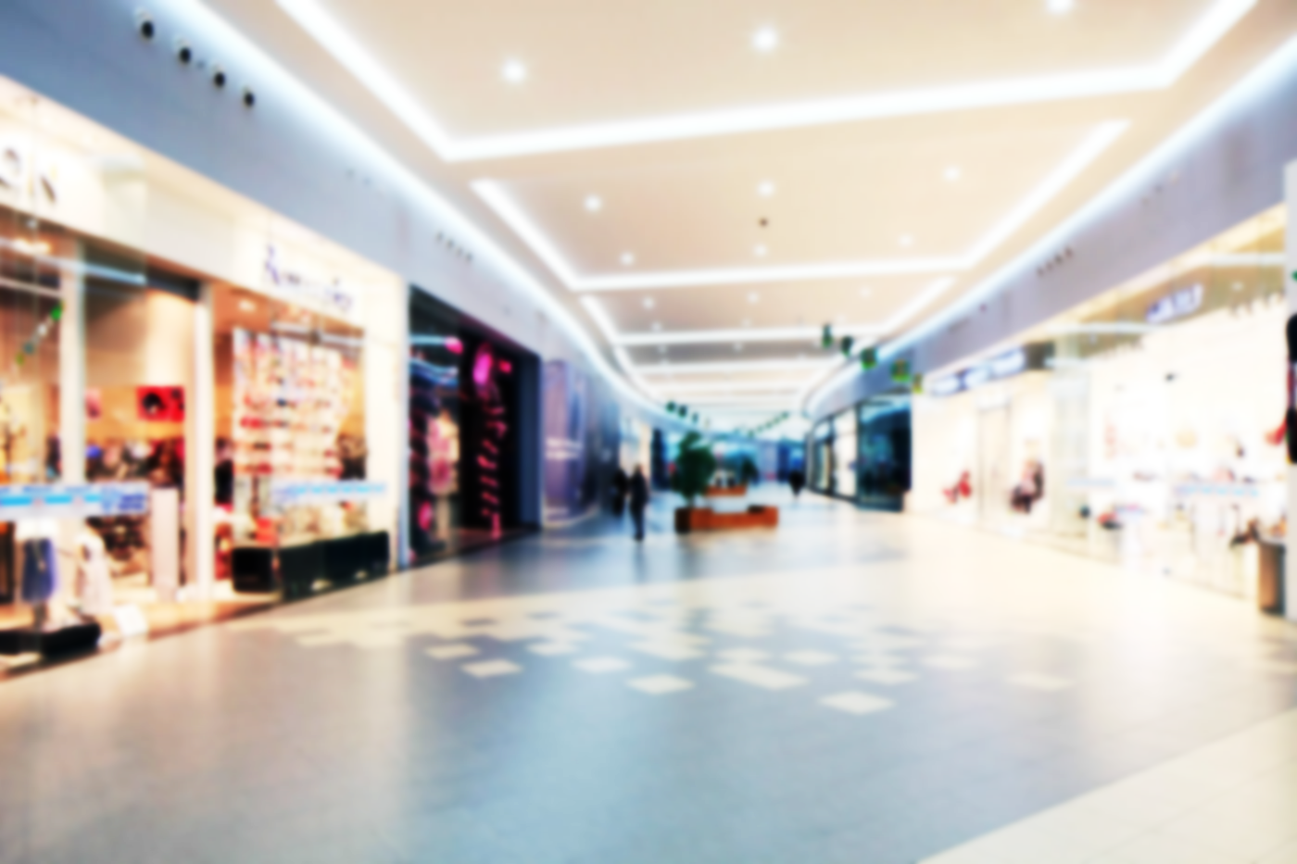





















Translation
Navigation
Payment
Shopping Assistant System
Searching
Sensor
Team #7
Yufeng Sun
Yuhan Liu
04/29/2019
Recharge
Database
Online Service
Personnel
Inspection
Replace
Repair
Recycle
Notes:
Team 7, Yufeng Sun from AEEM, Yuhan Liu from CEAS
Our project is Shopping Assistant System, the target consumer is the international tourists doing shopping in a big mall like Super Brand Mall in Shanghai.
This is the system operational concept.
The major part of the system is a robotic cart and a tablet with installed a software application which provides 3 major services, translation, navigation and information searching.
The system requires rent for use, and the robotic cart moves autonomously with keeping a certain distance to the tablet.
The communication between tablet and robotic cart is based on the Bluetooth low energy technology.
There will be a database storing all the information for software application to use.
About maintenance and support,
If the system is failed to be operated, some personnel in the mall will show up for support, the fault unit will be identified after performing an inspection, the fault unit will be replaced with new one, and transported to the maintenance shop for repairing. If it cannot be repaired, it will be disposed and recycled.

Slide 2
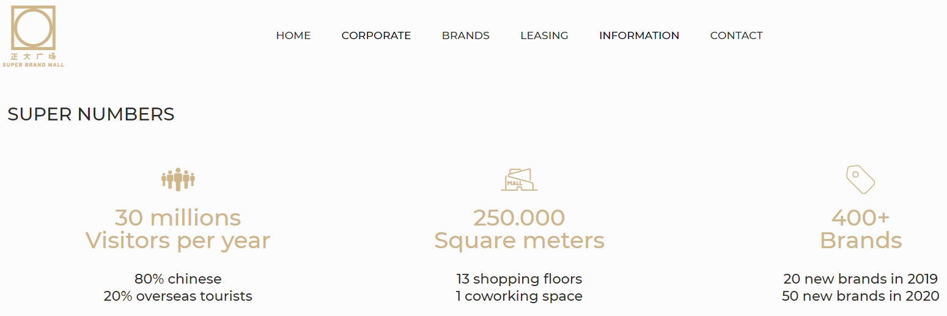
Motivation
Background - huge international tourism market
Billions of international tourist every year
6 million overseas tourist in SBM, Shanghai
Address customer (international tourist) needs
Time saving on searching right information
Energy saving on entire shopping time
Unique experience in shopping
Potential benefits to society
Differentiate mall in competition
Improve city image in global tourism
Attract more international tourists
Notes:
the background of our project is huge international tourism market, in 2016, there is already around 1.2 billion international tourists travel around the world which made a huge international tourism market. Take SBM in shanghai as a example, there are 6 million overseas tourists in 2018.
Many international tourists are likely to spend a lot of time on searching information during shopping and they are likely to be exhausted as they may carry many shopping bags. If we can make their shopping time saving and energy saving, they can have more time to enjoy their other activities in their trips.
the potential benefit to the mall is that it can differentiate the mall in the competition with other malls or online shopping. And for the city, it can improve city image in global tourism market and likely attract more international travelers.

Slide 3
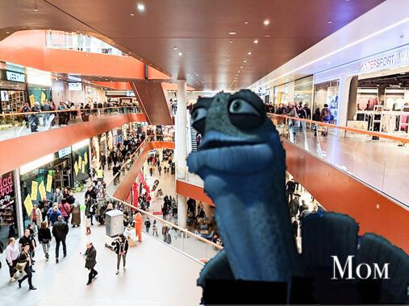
Purpose of the system
Provide an easy method for international tourists to save their time on searching right information and physical energy during shopping in a big mall like Super Brand Mall, Shanghai, hence to provide them an unique shopping experience.
When you are lost at the big mall and someone ask who you are looking for ?
Notes:
International tourists usually have a tight schedule and waste a lot of time on searching right information, even lost their way in big malls as they are in a strange place surrounding by people who do not speak their native language.
The purpose of the system is to provide an easy method for international tourists to save their time on searching right information and physical energy during shopping in a big mall like Super Brand Mall, Shanghai, hence to provide them an unique shopping experience.

Slide 4
Requirements Analysis
Customer Requirements |  | System Requirements |  | Design Requirements
CR1 | The system shall be easy for international end-users to interacted with. | SR1 | The system shall provide language service for interaction and translation. | DR1 | The system shall provide interaction with English, Chinese, German, Japanese and Korean.
 |  |  |  | DR2 | The system shall be able to translate English, German, Japanese and Korean to Chinese and Chinese to English, German, Japanese and Korean.
CR3 | The system shall be able to carry shopping bags. | SR6 | The system shall provide space to place certain amount weight shopping bags. | DR10 | The system payload shall be at least 20 kg.
CR4 | The system shall provide capability of searching availability, price and user comments of products and services. | SR7 | The system shall provide an application for end-users to search information of products and services in the mall. | DR11 | The system shall provide a product/service search application.
 |  |  |  | DR12 | The system shall provide a searching application that will give a recommendation based on end-users’ search criteria.
CR5 | The system shall provide capability of navigation. | SR8 | The system shall provide an application for navigating end-users to the store or spot where they want to go based on latest facility information. | DR13 | The system shall provide an indoor navigation application.
CR6 | The system shall be cheap to use. | SR9 | The system shall be cost effective. | DR14 | The system total cost should not exceed 1000$/per device.
CR7 | The system shall be able to be used for single purpose. | SR10 | The system shall be able to operated at least 12 hours a day. | DR15 | The system shall provide a long-hour battery to support 12 hours operation.
 |  | SR11 | The system shall provide detachable parts for different usages. | DR16 | The system shall consist of a payload device and a detachable controller.
Notes:
This is the RA of our project, some of the CRs are:
1,3,4 the system shall be easy for international end-users to interacted with for shopping convenience and be able to carry bags to save energy and provide information about the mall service and products. As we mentioned above, to solve the problem international tourists may face, the system shall have navigation service and also to meet different customers’ need, the system shall be used for single purpose.
We can pick up one of the CRs as an example showing how we develop our SRs and
DRs. for CR3: The system shall be able to carry shopping bags: this SR is our system shall provide enough space to place certain amount weight shopping bags hence the for our design requirements, the system payload shall be at least 20 kg.

Slide 5
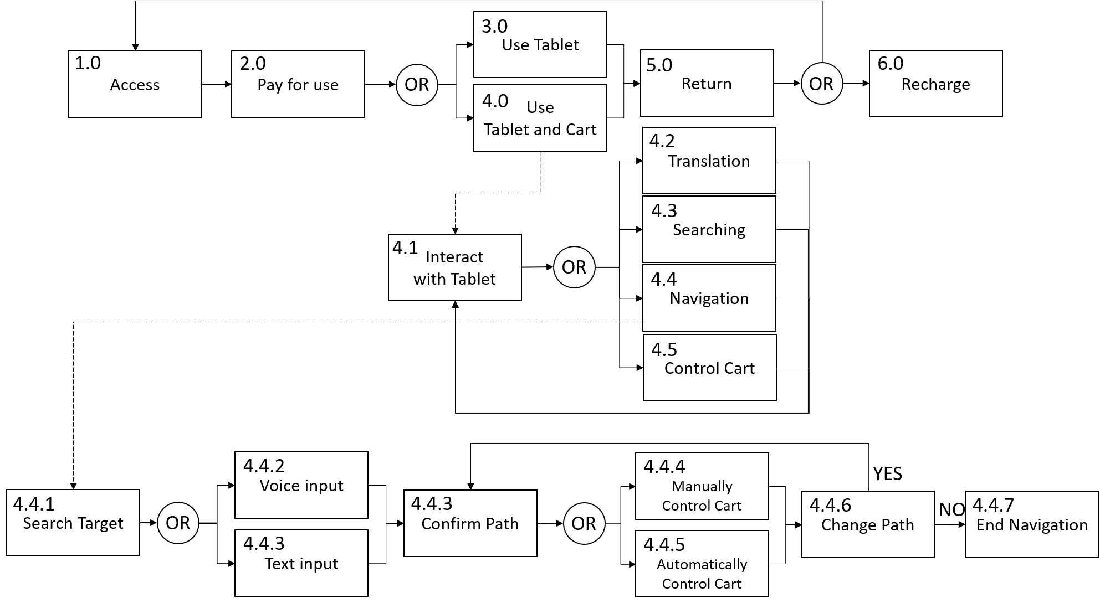
Functional Analysis
1st Level
2nd Level
3rd Level
Notes:
This is the FA of our project, in the first level, which is the operational level, customers start with accessing our shopping assistant system, they will be required to pay for using either tablet only or both tablet and robotic cart. They can return the tablet and cart after they finished their shopping then the cart and tablet will be ready for next use or recharged.
Then we develop the second level function for using tablet and cart: the customers will interact with software application we developed, in the software, they could choose to use different services and control the robotic cart.
Take navigation as an example, the 3rd level functional is developed here, customer start with inputting a target to search, either with voice input or text input, the navigation service will compute a path between the target position and current position of customers. Once customer confirms the path, they could either manually move cart or choose to automatically control the cart. Due to some environmental factors, the path can be updated, then customer need confirm the new path before continuing the navigation.

Slide 6
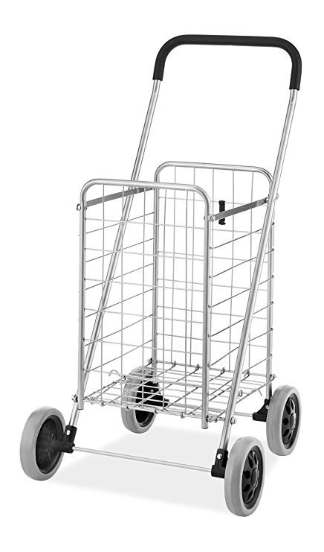
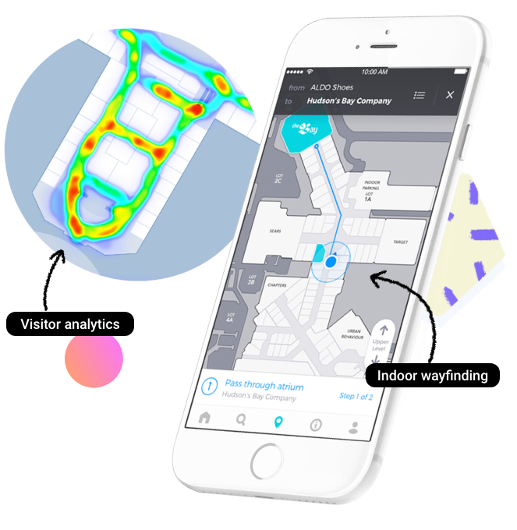
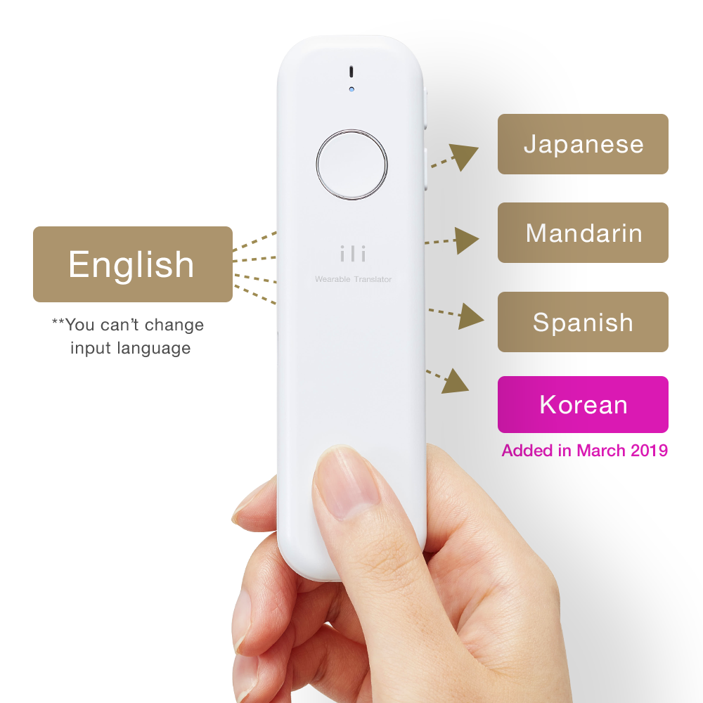
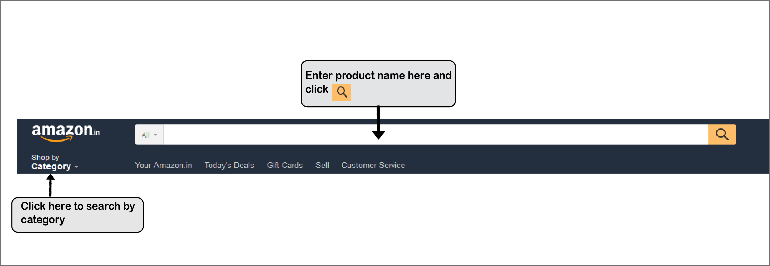
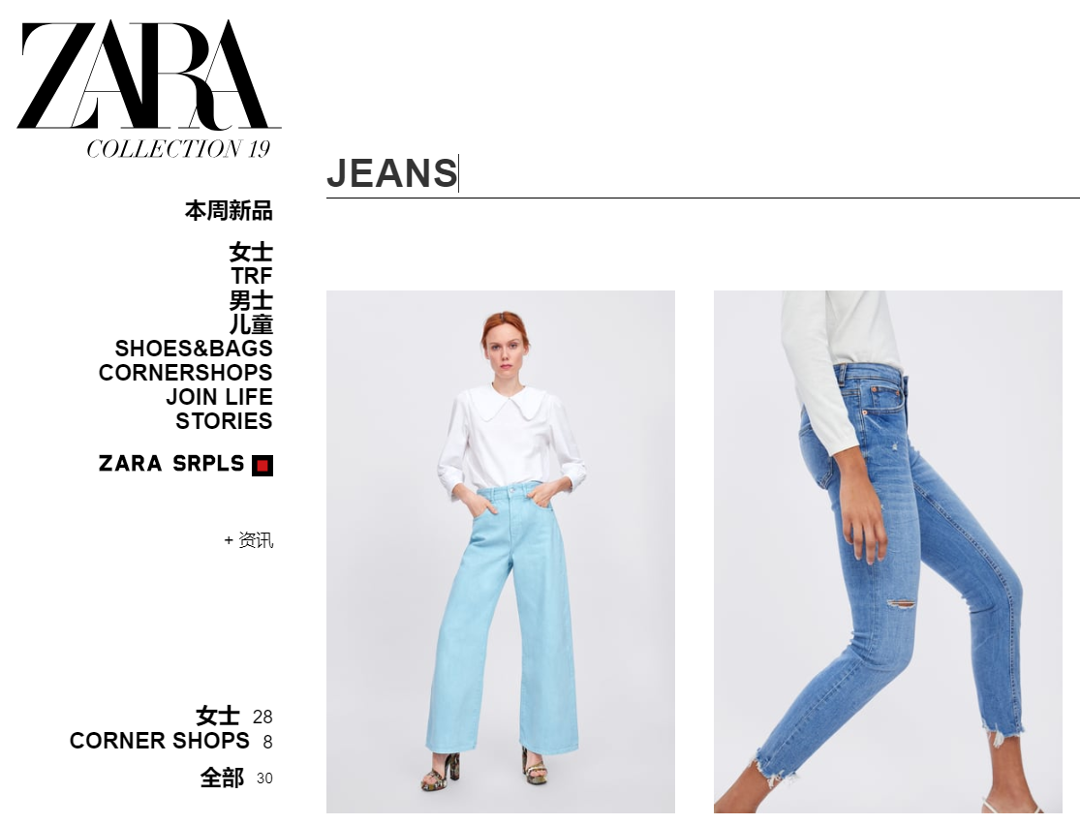
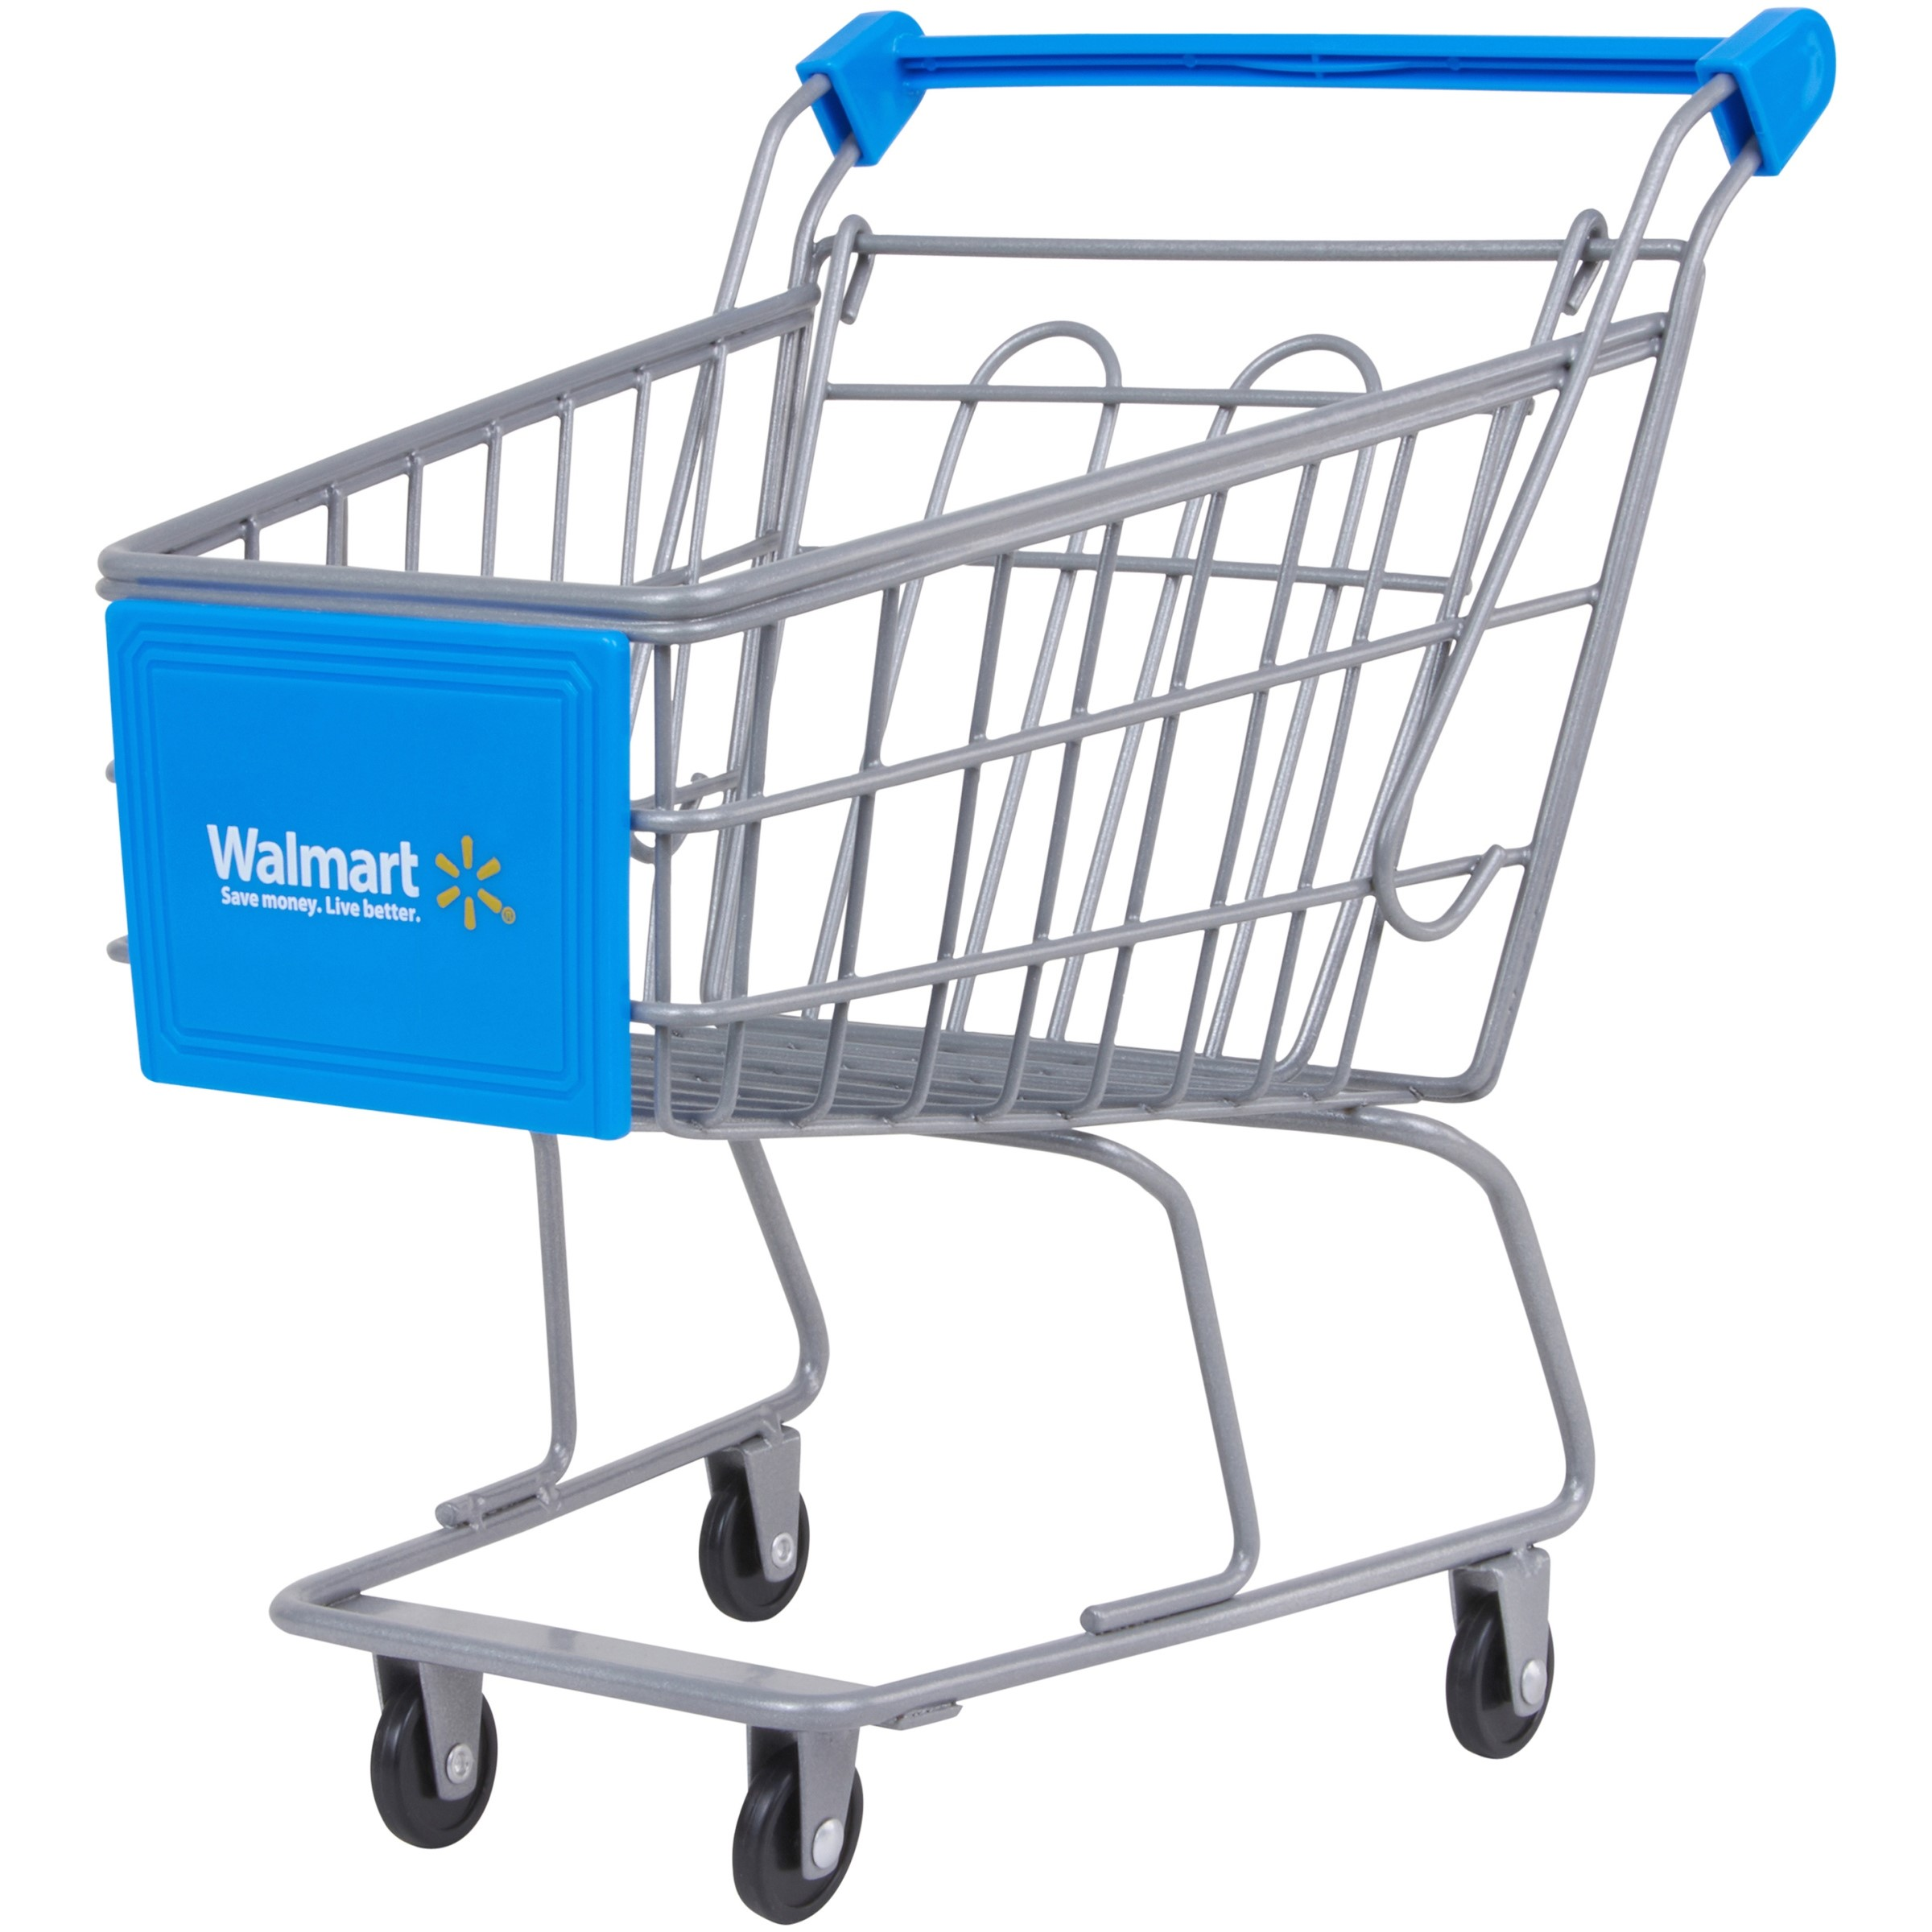
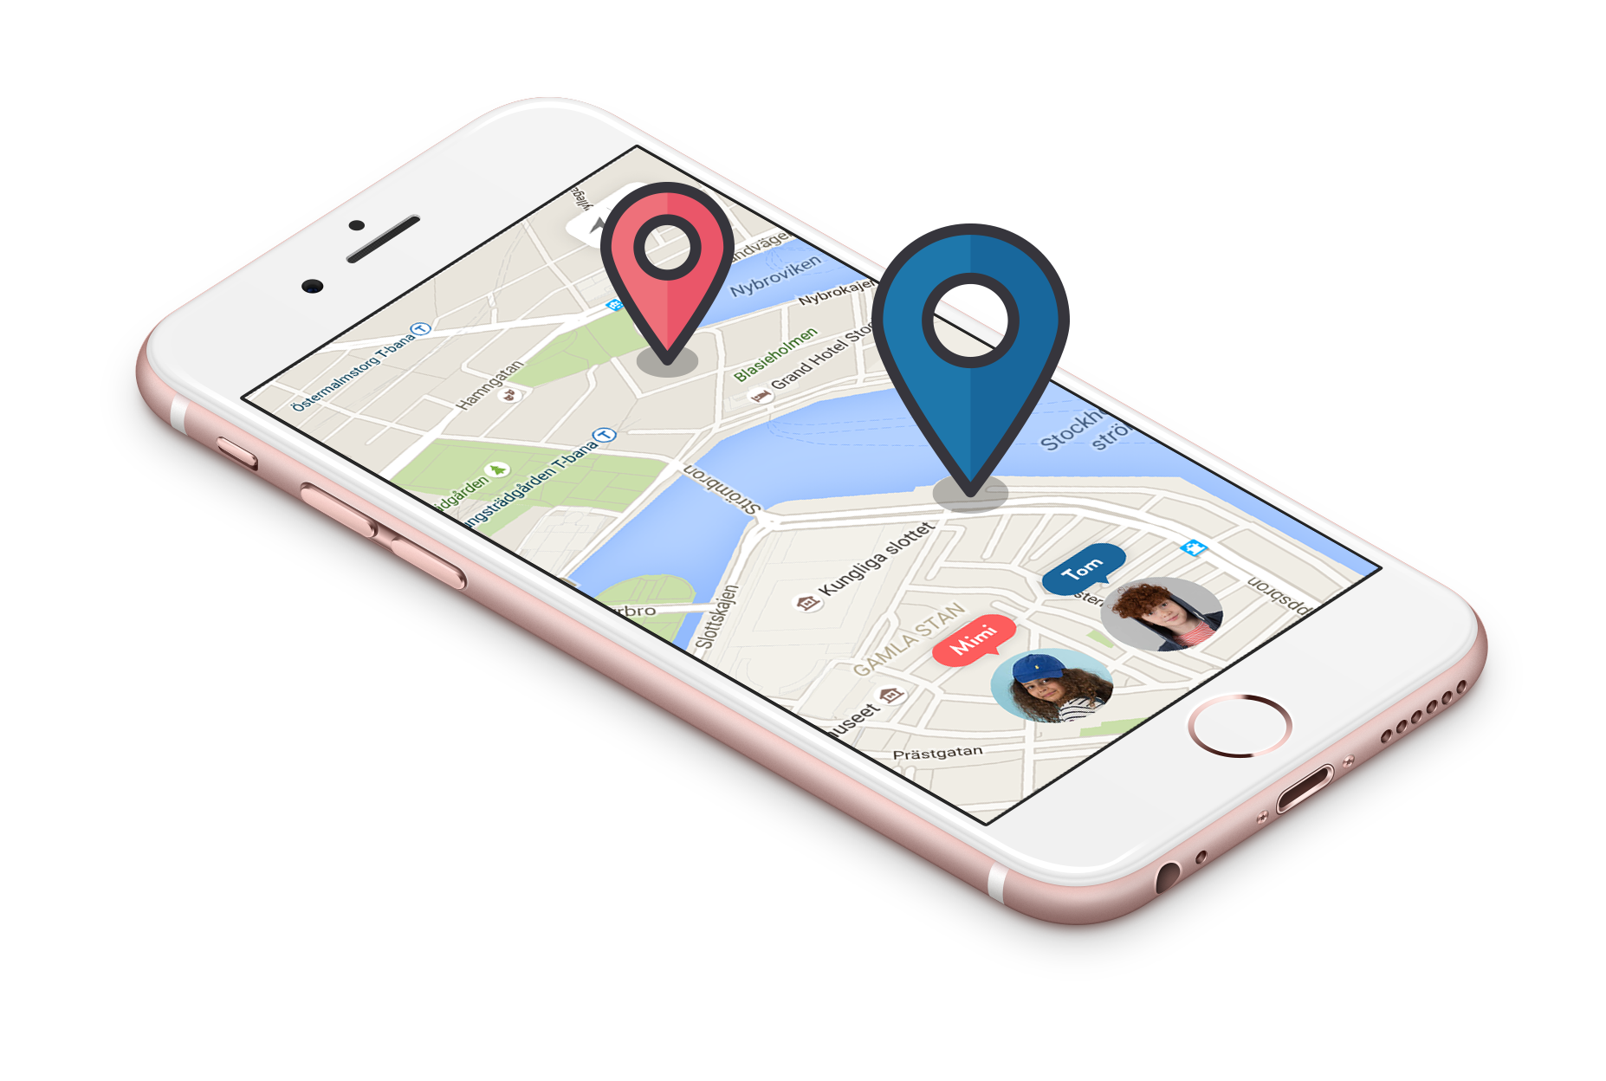
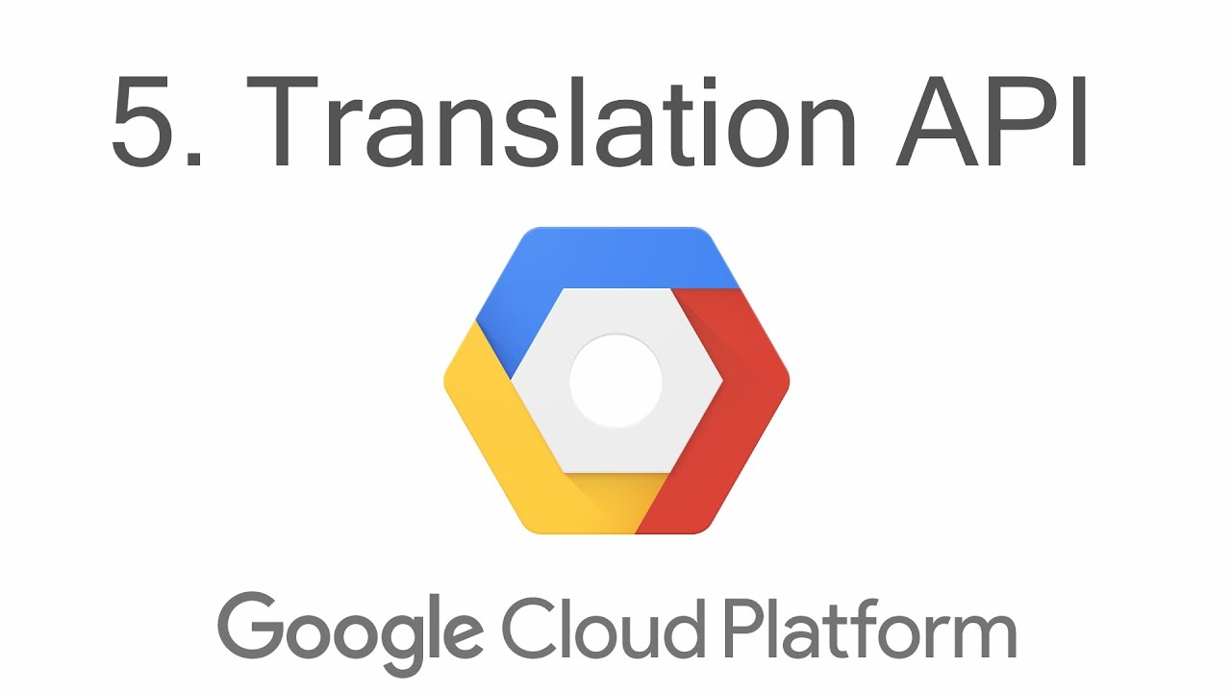
Conceptual Design
To address customer needs for carrying bags, navigation, translation, and information searching, existing technologies and devices were investigated.
Shopping Cart
Navigation
Translation
Information Searching
IPS
GPS
Notes:
To address customer needs for carrying bags, navigation, translation, and information searching, we have investigated some existing technologies and devices.
For shopping cart:
When choose shopping cart, there are some SC in supermarket and we can just take that. But for shopping in the mall, such cart is too big and unwieldy to go upstairs or downstairs. What’s more, it is not fit in the SM environment.
Another option is that we can choose to design new cart with specific shape to fit in big shopping mall. But we should consider the time cost and money to develop it. Also, the performance and payload should be tested to meet the customers’ requirements.
For Navigation:
Exiting technology for navigation is to use GPS or indoor position system. As GPS could not be used indoor because it’s no GPS signal inside the building, customers can only use indoor position system on phone to navigate and to support that, we can use IPS based on WIFI or Bluetooth.
Translation service:
For translation service, we can choose some available translation devices from market but the thing is that the cost is at least 120 $ each which is very expensive to those tourists who does not travel a lot.
And the second option is that we can choose to develop our own translation service which could be based on existing translation API or not. We need to have a further trade-off study on this.
Information searching：
we want to develop searching service like online shopping searching. Because we only find some brands which have search capability on their official website. This is not efficient for customers who want to search the product in the specific mall.

Slide 7
Conceptual Design
Combine all translation, navigation and information searching in one Software App Develop a light-weight, autonomously moveable cart which fits in mall
Tablet / Smart Phone
Translation service or
Based on translation API provider
Light-weight
Autonomous
Fit in mall
Indoor Positioning System based
On BLE or Wi-Fi
Product Searching
based on specific Mall
Robotic Cart
Software App
Notes:
Finally, we decided to combine all translation, navigation and information searching services in one Software Application and develop a light-weight, autonomously moveable cart which fits in mall.
The robotic cart can move around autonomously with keeping a certain distance to the tablet which is carried by customers. The communication between the robotic cart and tablet is based on BLE technology.

Slide 8
Risk Management Matrix
Key Activities
Robotic cart design, build and test
Software Application design, develop and test
Information system design, develop and test
Recharge system design, build and test
Payment system design, develop and test
System integration and test
Robotic cart manufacturing
System deployment
Personnel training
 | Marginal | Critical | Catastrophic
Probable |  | 1
Infrequent |  | 2,3
Remote |  | 4
Improbable |  | 5,6
Risk and mitigation plan
Risk # | Description | Severity | Likelihood | Risk Value | Mitigation
1 | Software development fall behind schedule | Critical | Probable | 8 | Include 20% more time in the project timeline to account for the delays
2 | Fail to develop translation service | Critical | Infrequent | 6 | Integrate online translation service for back up plan
3 | Fail to develop autonomous move | Critical | Infrequent | 6 | Include manually control mode of the robotic cart in design
4 | Navigation failure | Critical | Remote | 4 | Include the floor plan in the app
5 | Battery dead | Critical | Improbable | 2 | Include manually control mode of the robotic cart in design
6 | Unable to operate the system | Critical | Improbable | 2 | Design a help button on the cart for asking personnel support
Notes:
# Yufeng Detail Design, Key Activities and Risk Management
About detail design. The key activities are in 3 stages
First stage is research and development
robotic cart design, build and test
Software application design, develop and test
Information system design, develop and test
Recharge system design, build and test
Payment system design, develop and test
The system will be integrated and tested after all the hardware and software developed.
The second stage is manufacturing the robotic cart
The last stage before operation is system deployment which includes the hardware system installation and personnel training for how to do support and maintenance.
The will be some risks in project lifecycle as well as in operational stage.
For example, the software development might fall behind the schedule, our mitigation plan is to include 20% more time in the project timeline to account for the delays.
The batter of robotic cart is dead, the mitigation plan is to include manually control mode of the robotic cart in design.

Slide 9
3.0
TPM Allocation
Tablet Only
1.0
2.0
5.0
6.0
Access
Pay for use
OR
Return
OR
Recharge
4.0
Shopping Assistant System
-------------------------------------
A0 = 12 hours/day
MTBM = 4380 hours
McT = 72 hours
MLH/OH = 0.004
Tablet & Cart
Operational Flow
Maintenance Flow
10.0
11.0
12.0
13.0
14.0
15.0
Personnel support
Inspection & Isolate fault to unit level
Remove and replace unit
Transport to maintenance shop
Repair fault unit
Transport back to mall
Legend
A0 = Operational availability
MTBM = Mean time between maintenance
McT = Mean corrective maintenance time
MLH/OH = Maintenance labor hours per operational hour
FR = Failure Rate
MRT = Mean Response Time
Equipment
A0 = 12 hours/day
MTBM = 8760 hours
McT = 72 hours
MLH/OH = 0.008
Software App
A0 = 12 hours/day
MTBM = 8760 hours
McT = 12 hours
MLH/OH = 0.001
MRT = 0.5 seconds
Hardware System
A0 = 12 hours/day
MTBM = 8760 hours
McT = 72 hours
MLH/OH = 0.008
Recharge System
A0 = 12 hours/day
MTBM = 4380 hours
McT = 72 hours
MLH/OH = 0.016
Driving System
McT = 72 hours
MLH/OH = 0.008
FR = 0.0004
Mechanical Structure
McT = 72 hours
MLH/OH = 0.008
FR = 0.0001
Searching
McT = 12 hours
MLH/OH = 0.001
FR = 0.0004
MRT = 0.5 seconds
Translation
McT = 12 hours
MLH/OH = 0.001
FR = 0.0004
MRT = 0.2 seconds
Navigation
McT = 12 hours
MLH/OH = 0.001
FR = 0.0004
MRT = 0.5 seconds
Notes:
# Yufeng, Detail Design, Maintenance flow and TPM allocation
This is the operation flow of the system
Start with access to the system, customers are required pay for use either the table only or both the table and robotic cart. Once they finish their shopping, they could return the tablet and cart.
The cart will be accessed by other customers or be recharged at the recharge center if the battery fall below of certain level.
In the maintenance flow
If the robotic cart or the tablet are failed to be operated, some personnel in the mall will show up to support, with some inspection, the fault will be isolated to unit level and fault unit will be removed and replaced with a new one and then be transported to maintenance shop for repairing, and will be transported back to mall after repaired.
The major technical performance measure of the system are operational availability, mean time between maintenance, Mean corrective maintenance time, failure rate.
The technical performance measure are allocated to each sub systems, for example the software app, it shall be able to be operated at least 12 hours a day, the mean time between maintenance should be around one year, and the mean corrective maintenance time should be 12 hours and the mean response time should be 0.5 second.

Slide 10
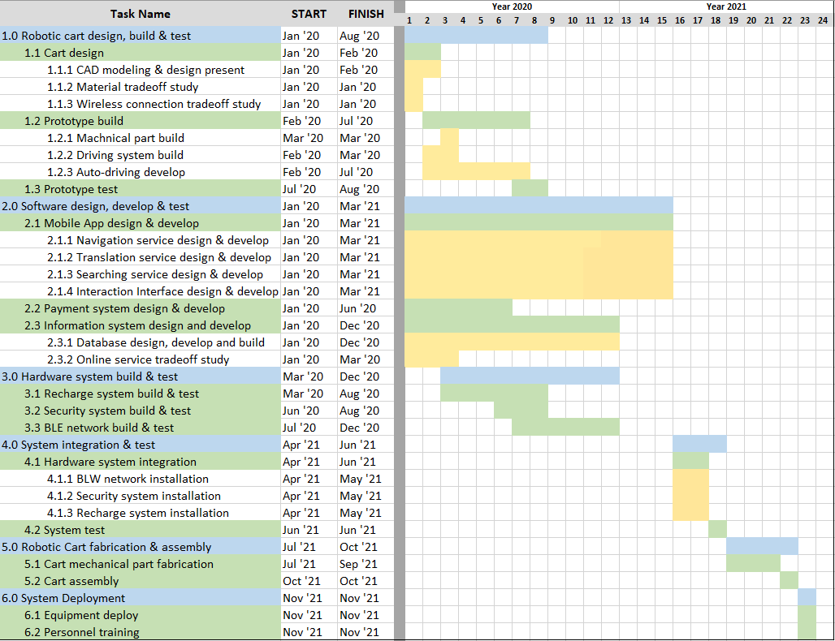
1.1
Work 5%
1.1.1
Work 3%
Gantt Chart
1.0
Work 20%
Cart design
CAD modeling
& design present
Robotic Cart design, build and test
1.2
Work 14%
1.1.2
Work 1%
Prototype build
Material tradeoff study
1.3
Work 1%
1.1.3
Work 1%
Prototype test
Wireless connection tradeoff study
2.0
Work 50%
Software design, develop and test
2.1
Work 35%
1.2.1
Work 3%
Work 100%
Mobile App design and develop
Mechanical part build
2.2
Work 8%
1.2.2
Work 3%
Payment system design and develop
Driving system build
3.0
Work 10%
2.3
Work 7%
1.2.3
Work 8%
Hardware system build and test
Information system design and develop
Auto- driving develop
Shopping Assistant System
3.1
Work 2%
2.1.1
Work 8%
Recharge System build and test
Navigation service
design and develop
4.0
Work 4%
3.2
Work 3%
2.1.2
Work 10%
System integration and test
Security system build and test
Translation service
design and develop
3.3
Work 5%
2.1.3
Work 8%
BLE network build and test
Searching service design and develop
5.0
Work 15%
5.1
Work 13%
2.1.4
Work 7%
Robotic cart fabrication and assembly
Cart Mechanical Part fabrication
Interaction design and develop
5.2
Work 2%
2.3.1
Work 5%
Cart Assembly
Database design and develop and build
6.1
Work 0.5%
2.3.2
Work 2%
6.0
Work 1%
Equipment deploy
Online service tradeoff study
System deployment
6.2
Work 0.5%
WBS
Personnel training
Notes:
# Yufeng, WBS, Gantt Chart
The work breakdown are list on the left of this slide.
There are 6 major high level tasks, including robotic carts design, build & test, Software application design, develop and test, Hardware system build and test, system integration and test, robotic cart fabrication and assembly, and finally system deployment.
The right is the Gantt Chart for each task’s estimation, and software application design, develop and test is the main time consuming work among all the works, normally, it requires 12 months for developing and testing, but in order to mitigate the risk, we include 20% more time in the estimation. So from the estimation, the whole project will require around 2 years for developing before putting in to use.

Slide 11
B
6 mo
Prototype build
C
PERT & CPM Analysis
8 mo
Hardware system
build & test
2 mo
Prototype test
3 mo
System integration
& test
4 mo
Manufacturing & Assembly
2 mo
Cart design
D
E
F
1 mo
Deployment
G
12 mo
Software App development
A
Activity | Predecessor | To(mo) | Tn(mo) | Tp(mo) | Te(mo) | Variance
A
B | A | 1 | 2 | 4 | 2.17 | 0.25
C | B | 4 | 6 | 8 | 6 | 0.44
D | A,B,C | 8 | 12 | 15 | 11.83 | 1.36
E | D | 2 | 3 | 4 | 3 | 0.11
F | E | 3 | 4 | 6 | 4.16 | 0.25
G | F | 0.5 | 1 | 2 | 1.08 | 0.06
Critical Path: A:D:E:F:G
With 20 months project time
Z = (20-20.07)/sqrt(1.78)=-0.05
The probability of meeting the schedule: 48%
With 20% more time in Software App develop
Z = (22.4-20.07)/ sqrt(1.78)=1.75
The probability of meeting the schedule: 96%
Notes:
# Yufeng, PERT and CPM analysis
This is the PERT (Program Evaluation Review Technique) Chart and CPM (Critical Path Method).
Given each work an estimation on optimistic time, normal time and pessimistic time, we could calculate the expect time and the variance for each work.
And the critical path could be found.
With give 20 month project time, the probability of meeting the schedule is 48%
With put 20% more time in Software app develop, the probability of meeting the schedule is 96%

Slide 12
Items |  |  | Unit Price | Quantity | Cost ($)
Research & Development | Manager |  | 100,690 $/yr | 1*1.5 yr | 151,035
 | Architect |  | 100,690 $/yr | 1*1.5 yr | 151,035
 | Quality Team |  | 100,690 $/yr | 2*1.5 yr | 302,070
 | Robotic Cart Team |  | 100,690 $/yr | 2*0.5 yr | 100,690
 | Software Dev Team | Mobile Application | 100,690 $/yr | 4*1.5 yr | 604,140
 |  | Payment system | 100,690 $/yr | 1*0.5 yr | 50,345
 |  | Information System | 100,690 $/yr | 1*1 yr | 100,690
 | Hardware Develop | Recharge system | 6,000 $/set | 5 sets | 30,000
 |  | Security system | 10,000 $/set | 1 set | 10,000
 |  | BLE network | 50 $/unit | 3000 units | 150,000
 | Material & Equipment | Cart prototype | 2,000 $/unit | 1 unit | 2,000
 |  | Database & Support | 80,000 $/yr | 5 yr | 400,000
 | System Integration & Test | Hardware installation | 20,000 $/event | 1 event | 20,000
 |  | System test | 10,000 $/event | 2 events | 20,000
Manufacturing | Tablet |  | 150 $/unit | 100 units | 15,000
 | Robotic Cart |  | 500 $/unit | 150 units | 75,000
Operation & Maintenance | Software update |  | 50,000 $/yr | 5 yr | 250,000
 | Personnel training |  | 2,000 $/event | 2 events | 4,000
 | General Maintenance |  | 100,000 $/yr | 5 yr | 500,000
 |  |  |  | Total Cost($) | 2,936,005
Engineering Economics
Assumptions:
Average annual salary: 100,690 $
SAS rent rate: 2 $ per hour
70% usage for each unit
Notes:
With some assumptions, we could give a estimation of the cost for the whole life cycle of the project.
The research & development will last for around 15 months, the manufacturing and system deployment will be completed in additional 8 months.
The system will be put into use 2 years later from now.
The total cost for 3 stages of the project will be around 3 million, with including the salary pay for 12 members team for 1.5 year, by assuming 100,690 dollars as the average annual salary for each person.
In the operation stage, the cost includes the database use and support fee, software update fee, and cost of other general maintenance, like fault unit transportation, repair and replace.
As the Mall will be our business partner in this project, the cost in this slide does not include the cost of electric charge and salary pay of mall employees who are responsible for the maintenance and support in this project.
We will try to make money from this project.
Assuming the rent rate of the system is 2 dollars per hour per unit, with 70% usage (8.4 hours a day) for each unit, the system will bring around 1 million dollars annually. So, in the fifth year, we can make profit from this project.

Slide 13
Questions?

Slide 14
References
https://en.wikipedia.org/wiki/Program_evaluation_and_review_technique
https://en.wikipedia.org/wiki/Super_Brand_Mall
https://en.wikipedia.org/wiki/Indoor_positioning_system
https://senion.com/indoor-positioning-system/
https://iamili.com/us/

Slide 15
Requirements Analysis
CR2 | The system shall be easy to maneuver in the mall. | SR2 | The system shall be able to accept voice input and text input. | DR3 | The system shall be able to accept text input and recognize voice input and translate voice input to text.
 |  |  |  | DR4 | The system shall be able to accept credit card payment and mobile payment.
 |  |  |  | DR5 | The system shall be able to be returned in any appropriate spot in the mall.
 |  |  |  | DR6 | The system shall be able to display remaining time for using.
 |  | SR3 | The system shall be easy to pay for use and easy to return.
 |  |  |  | DR7 | The system shall be able to track the end-user and be able to follow the end-user autonomously.
 |  |  |  | DR8 | The system shall be able to switch between autonomous control and manually control.
 |  | SR4 SR5 | The system shall be able be controlled autonomously and manually. The system shall be lightweight and in appropriate small size. | DR9 | The system shall weigh no more than 8 pounds in total and system size shall not exceed 10 inches width, 20 inches length and 30 inches height.

Slide 16
Design Options and Tradeoffs
 | Shopping Cart | Navigation | Translation | Information Searching
Design Option1 | Existing cart: Existing shopping cart, just take too big and unwieldy to move not fashion enough | IPS: (based on Wi-fi or BLE) We can use Indoor Position System to navigate inside mall | Translation device: Existing translation device on the market. Expensive as the price is at least above 120 $ each | Develop searching service like online shopping searching: Need database Cost time and money in developing
Design Option2 | Design new cart Cost more time and Money Specific shape to fit in mall | GPS: It can not be used indoor as there usually no GPS signal inside the building. | Existing Translation API: Develop translation based on the existing API Cost a little time and money in developing Pay for using the translation based on words count | Specific Brand Searching: Good to find product of specific brand Not specific to the product in the mall Two many brands and no comparison

Slide 17
Design Options and Tradeoffs
Indoor Positioning System
 | Wi-Fi | Bluetooth Low energy
Speed | < 1.3 Gps, ideal for bigger files and data | 1 Mbps, small data
Accuracy | Use ISM radio band to communication, does not rely solely on the proximity of the user. | Location accuracy ensured by a unique UID number
Transmission Range | 160 ft indoor, depending on frequency and power | 50 feet ~ 1500 feet
Power Consumption | 10 times more than BLE | Lower power consumption, can run single battery for over 2 years
Deployment Costs | Needs router configuration and power source | Less costly, no configuration is required

Slide 18
WBS
4.1.1
Work 1%
BLE network installation
4.1
Work 3%
4.1.2
Work 1%
4.0
Work 4%
Hardware system integration
Security system installation
System integration and test
4.1.3
Work 1%
Recharge system installation
4.2
Work 1%
System test

Slide 19
WBS in operation
Unscheduled Maintenance
Operation
Scheduled Maintenance
Software update
Personnel training

Slide 20
Motivation
Challenges
The software service development is the biggest challenge in this project as it leverage new technologies such as indoor positioning with BLE, translation with voice input, navigation path planning in a multiple floors building and autonomously moving robot.

